Slide 1
Pitch deck
The Metrics Marvels
Brevi, G., Czempas, M., Jagan, R., Janes, P., Ntwari, J.C.

Slide 2




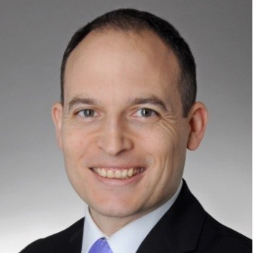

ABOUT METRICS MARVELS
At Metrics Marvels, we empower non-profit organizations with a means for them to assess not only their actions, but the IMPACTS of those actions.
HELPING NON-PROFITS Measure IMPACT, NOT JUST NUMBERS
Notes:
Paul: Analagoy of NPO to boxer

Slide 3

PROBLEM
Non-profit orgs need some means to demonstrate impact to secure sustained funding
BUT ………..
Lack of standardization in impact reports
Overwhelming # of KPIs to consider
Current impact reports often focused on actions, but not the impact of those actions
Notes:
Gabriel’s slide
Actions are eg number of hackathons, number of participants Impacts are eg met new contacts/ expanded network, hired by partner, new skills acquired
IRIS+ framework overwhelming number of KPIs and many will not be relevant to a particular NPO. Also does not help with how to measure the KPI.

Slide 4
SOLUTION
IMPACT ASSESSMENT PLATFORM
EVENT IMPACT TRACKING
We show you the impact your events had on the participants and partners, and how well it met their aims
AND COMING SOON …….
IMPACT REPORT GENERATION
SOCIAL MEDIA ENGAGEMENT
One-click annual impact report generation
We help you track user engagement across your social media channels
FUNDING SOURCES
We notify you of existing + new potential funding sources
Notes:
Magdalena’s slide
Potential sources of funding: grants and funds. New sources can become available at any time and it is easier for us to monitor vs each and every NPO to try to stay abreast. Can do smart matching using AI to make sure there is some fit with qualifying criteria for grant.

Slide 5
RESHMA’s SLlDE
Notes:
Reshma’s slide
Survey screenshot plus mentioning how follow up event survey is linked to the LinkedIn certification badge that is already used.

Slide 6
JEAN CEDRIC’s SLlDE
Notes:
Jean Cedric’s slide
Dashboard screenshot and expolain it

Slide 7
THANK YOU
The Metrics Marvels
Notes:
Say thank you altogether as team

